Slide 1
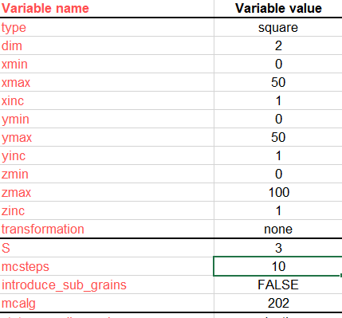
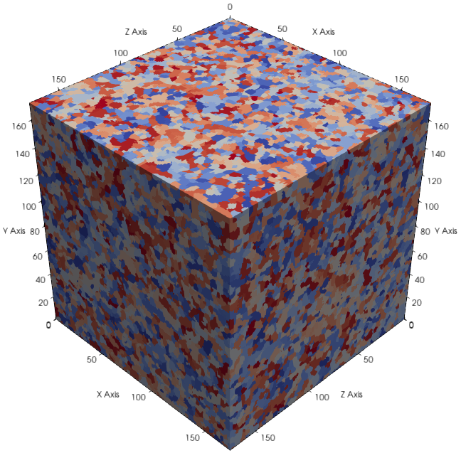
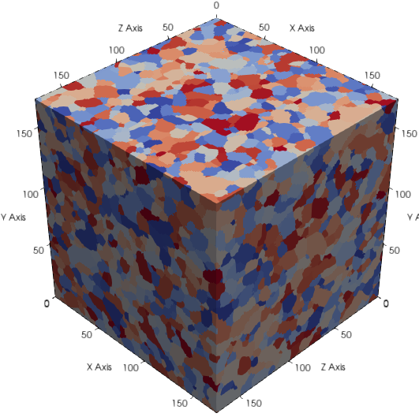
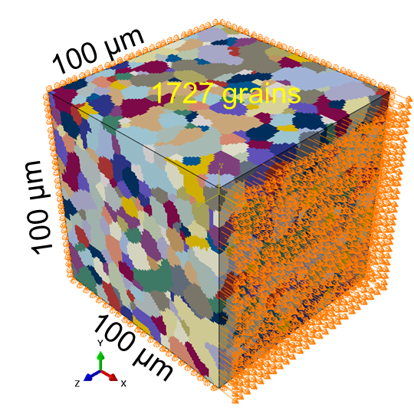
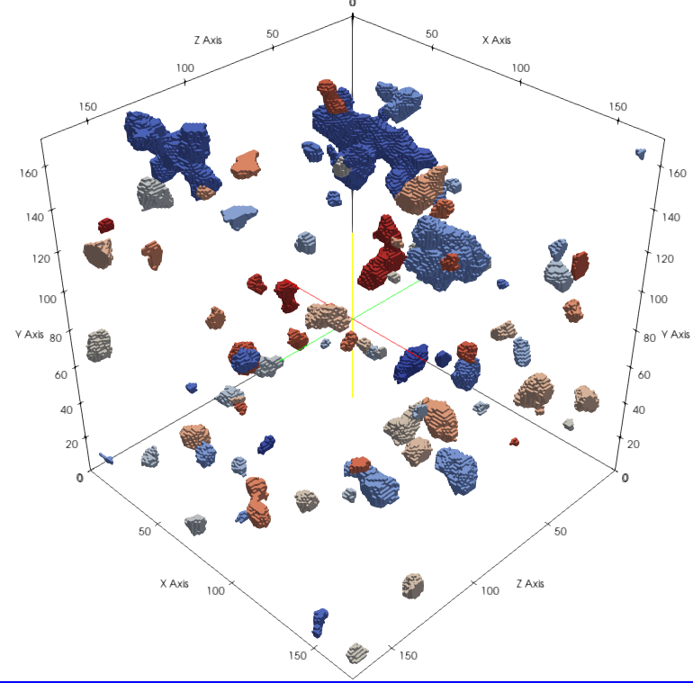
pxt = mcgs()
pxt.simulate()
pxt.detect_grains()
pxt.char_morph_2d(8)
pxt.map_ori()
pxt.export_ctf_slices()
Stack .CTF files
Export .inp files
ABAQUS
Dream3D
UPXO
input_dashboard
(a)
(b)
(c)
(d)
(e)

Slide 2
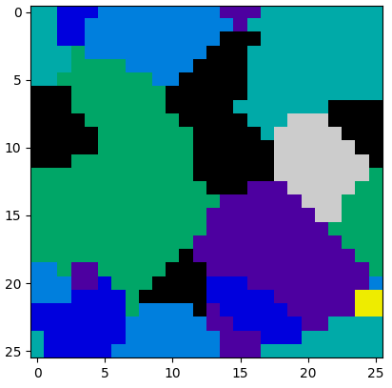
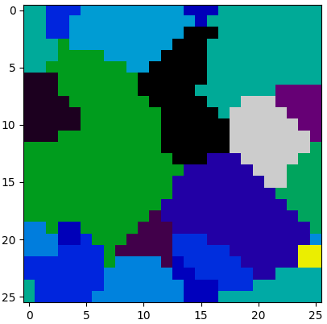
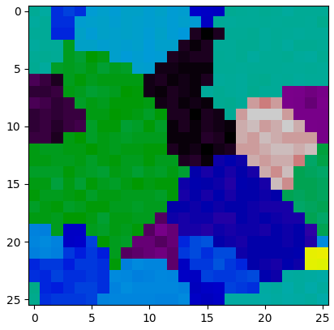
Introducing orientation gradients in synthetic grain structures
No in-TC orientation gradients
No in-grain orientation gradients
In-TC orientation gradients, [-7.5, 7.5]
No in-grain orientation gradients
In-TC orientation gradients, [-7.5, 7.5]
In-grain orientation gradients, [-2.5, 2.5]
TODO: Include IPF-Z scatter plots for each
plt.imshow( (euler1+euler2+euler3)/3 , cmap = 'nipy_spectral')

Slide 3
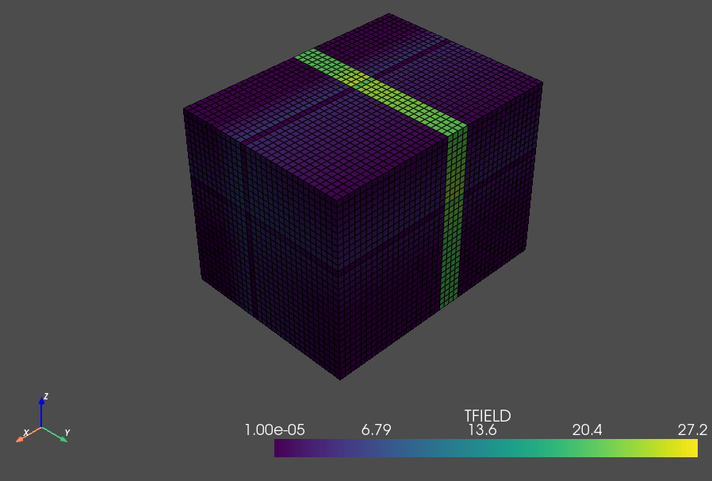
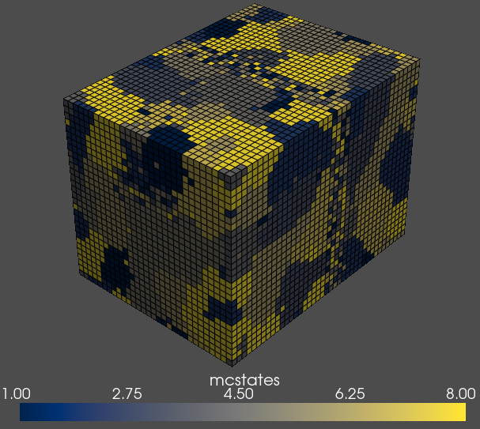

Slide 4
grid
2D
3D
monte_carlo_grain_structure
grain structure t1
ebsd slice(s)
grains 1 to n1
grain boundary points
grain boundary junction points
grain boundary segments
xtal oris

Slide 5
